Slide 1
Object Oriented Programming
Unit -1
Introduction

Slide 2
Chapter Outline
Overview of structured and object oriented programming approach
Characteristics of object oriented languages

Slide 3
Structured Programming Approach
Structured Programming divides a program into a set of functions or modules.
These functions have statements embraced inside curly braces.
Each of these functions performs a subtask.
Usually, as each function represents a specific functionality, it is easier for the programmer to test and debug the code, but this can differ depending on the program.
C language and Pascal are two common structured programming languages.
It is also known as Modular programming .

Slide 4
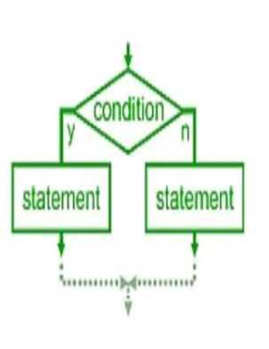
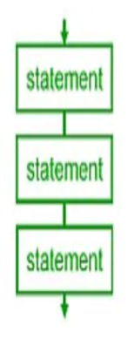
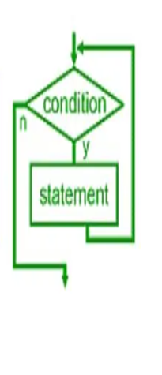

Slide 5
Object Oriented Programming
Object oriented programming allows the programmer to represent real-world scenarios using objects.
An object is any entity that has states and behaviours. States represent the attributes or data of an object, whereas the methods represent the behaviours of objects.
Student, Employee, Book etc. are objects. These objects interact with other objects by passing messages.
Furthermore, a class is a blueprint for creating an object. It is necessary to have a class to create objects. For example, to create an Employee object, there should be an Employee class.

Slide 6
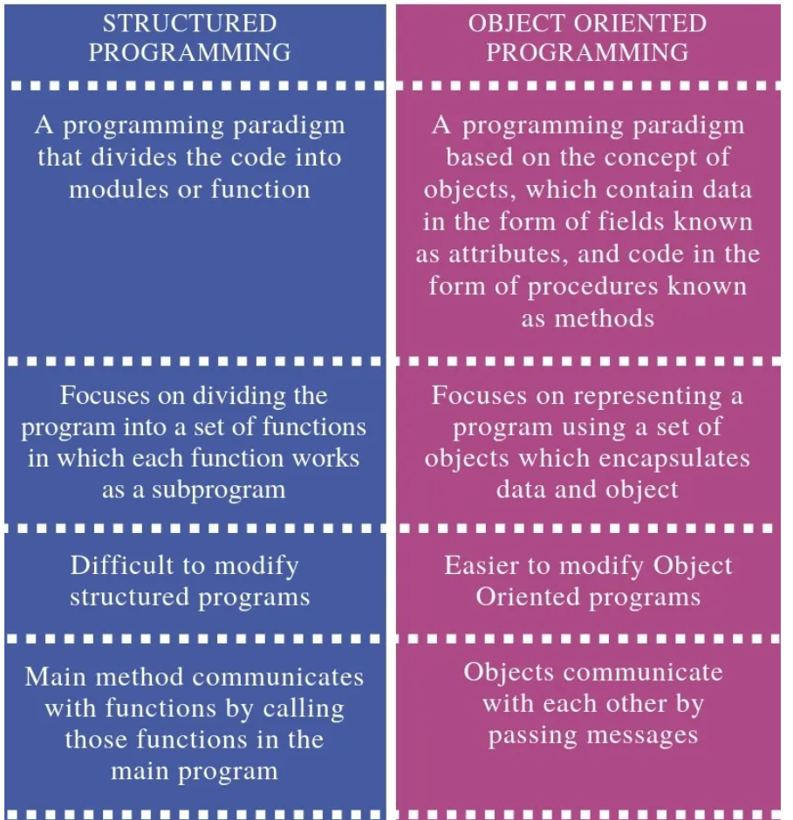
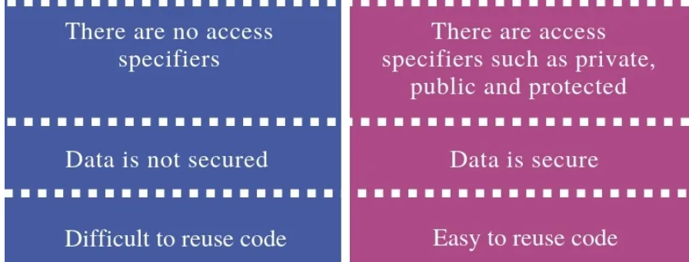

Slide 7
Characteristics of object oriented languages
Object,
Class,
Data Abstraction,
Encapsulation,
Inheritance,
Polymorphism,
Dynamic Binding, and Message Passing

Slide 8
Class
Class can be understood as a template or a blueprint, which contains some values, known as data members, and some set of operations, known as behaviours or methods.
The data and methods that are defined in the class are automatically taken when an object is created.
The class is a template or blueprint for objects. One can make as many objects as they want to be based on a class.

Slide 9
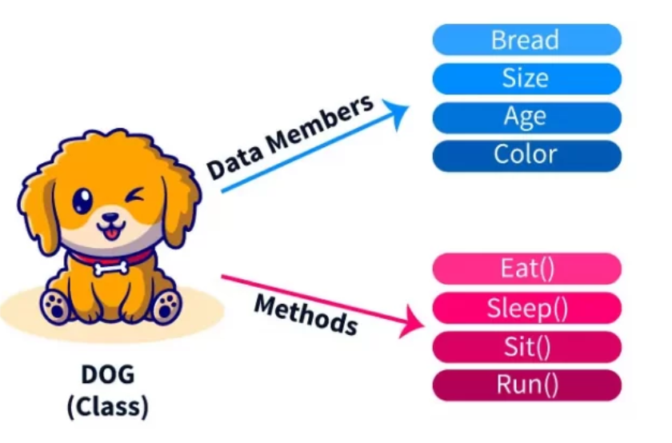

Slide 10
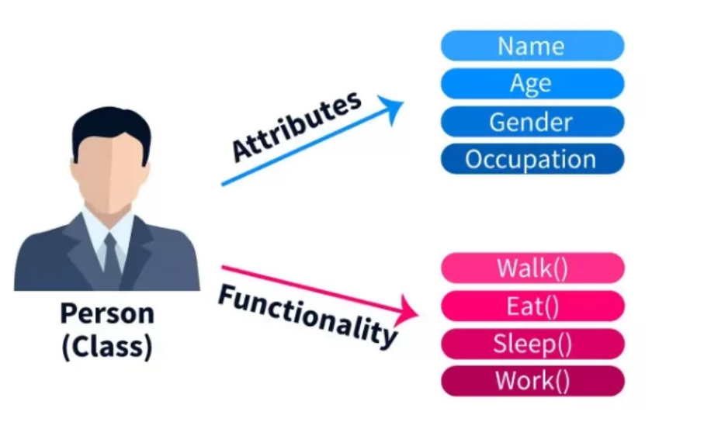

Slide 11
Object
A class contains the properties and behaviour for a set of objects, many objects can be formed using a class.
Take the example of a dog as an object.
There are different varieties of dogs that means different varieties of objects according to the dog class. For example, one dog has black color, another dog may have grey color, or white, etc.
However, we can notice that most of the behaviours are the same like barking, wagging their tail, eating, sleeping, etc.
Properties and behaviour of these objects can be the same but their values would be different.

Slide 12
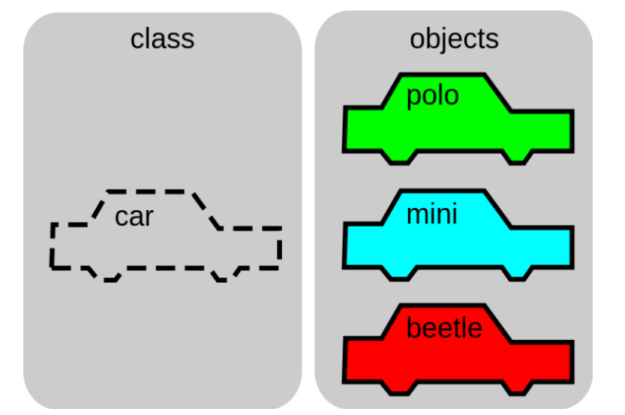

Slide 13
Abstraction
Abstraction means displaying only essential information and hiding the details.
An object contains some properties and methods.
We can hide them from the outer world through access modifiers.
We can provide access only for required functions and properties to the other programs.

Slide 14
Abstraction
There are two types of abstraction.
Data Abstraction
Process Abstraction

Slide 15
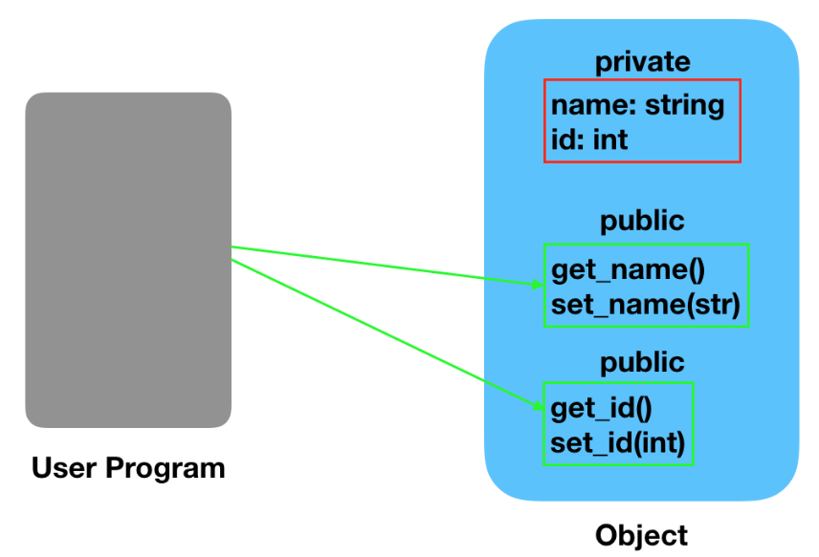
Data Abstraction
When the object data is not visible to the outer world, it creates data abstraction. If needed, access to the Objects’ data is provided through some methods.

Slide 16
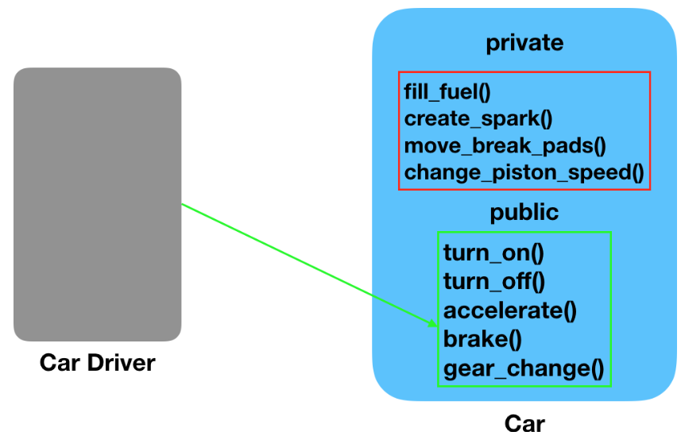
Process Abstraction
We don’t need to provide details about all the functions of an object. When we hide the internal implementation of the different functions involved in a user operation, it creates process abstraction.

Slide 17
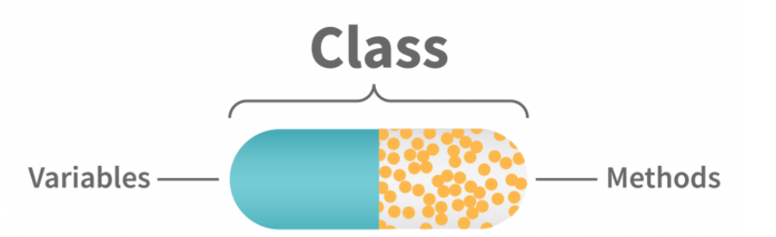
Encapsulation
OOP emphasizes the encapsulation of data and functionality within objects.
Objects are defined with data and specific functionality that governs the interactions between the objects.
It prevents hackers from viewing the details of the data and the data structure itself.

Slide 18
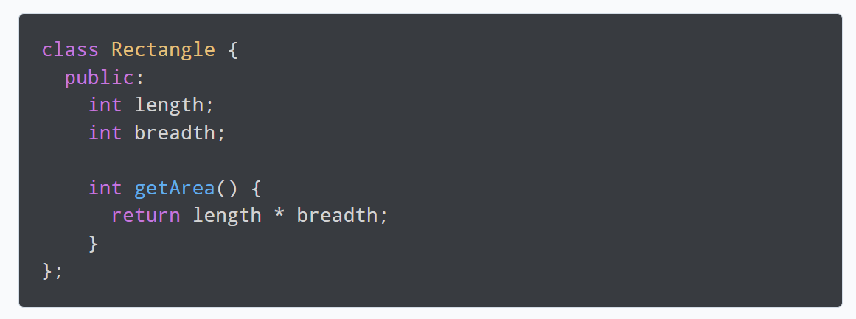

Slide 19
Inheritance
Inheritance allows classes to be related to each other so that a child class can inherit from a parent class and access the same methods, functions, and variables that the parent class has.
Inheritance structure makes it easier for developers to structure any large projects and create code reuse.
The inheritance model provides a simple and effective way for a development team to manage complexity in their project by abstracting away details from the child classes.

Slide 20
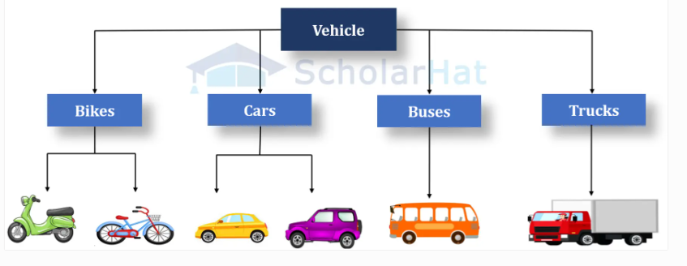

Slide 21
Advantage of inheritance
Code Reusability
Easier Maintenance
Polymorphism
Extensibility
Readability

Slide 22
Polymorphism
Polymorphism is a Greek word that means to have many forms.
Polymorphism causes a member function to behave differently based on the object that calls/invokes it.
It occurs when you have a hierarchy of classes related through inheritance.
For example, suppose we have the function makeSound(). When a cat calls this function, it will produce the meow sound. When a cow invokes the same function, it will

Slide 23
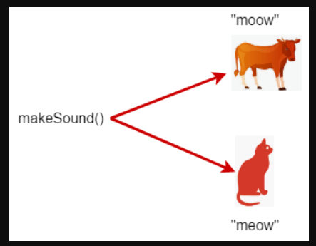

Slide 24
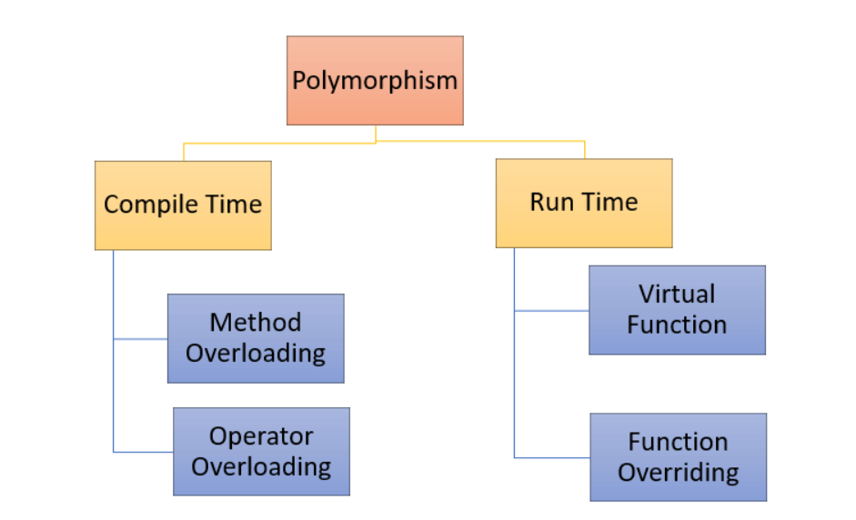

Slide 25
Dynamic Binding
The general meaning of binding is linking something to a thing. Here linking of objects is done. In a programming sense, we can describe binding as linking function definition with the function call.
So the term dynamic binding means to select a particular function to run until the runtime. Based on the type of object, the respective function will be called.
As dynamic binding provides flexibility, it avoids the problem of static binding as it happened at compile time and thus linked the function call with the function definition.

Slide 26
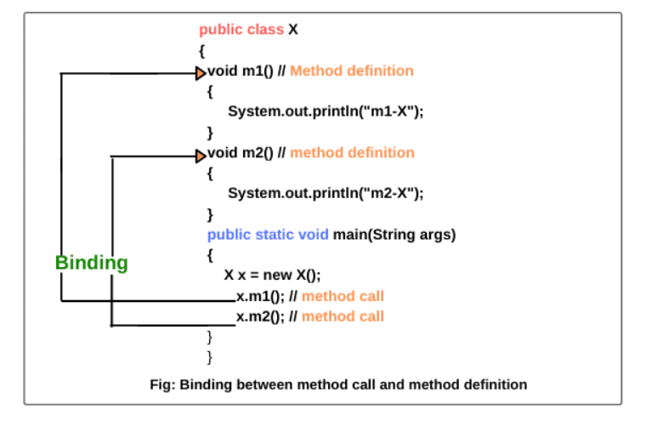

Slide 27
Message Passing
Message passing in C++ involves passing objects or data between different parts of a program using functions, methods, or message queues.
Objects communicate by sending and receiving data. A message for an object is a request for the execution of a procedure, and as such, it will invoke a function in the receiving object that produces the desired results.
Message passing entails specifying the object’s name, the function’s name, and the data to be sent.

Slide 28
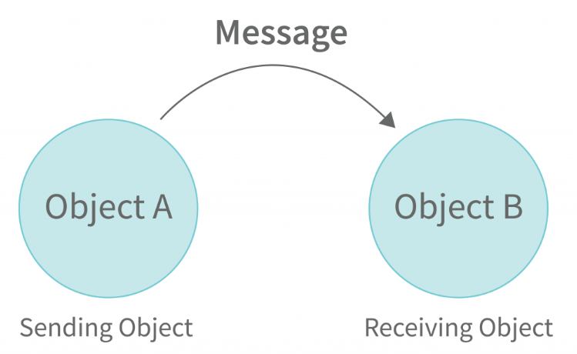

Slide 29
Thank You

